Slide 1

InsurAI - Corporate Policy Automation System
Transforming enterprise insurance management through intelligent automation and real-time transparency

Slide 2
Include:
Project Name: InsurAI – Corporate Policy Automation & Intelligence System
Team Number:- Batch - 3( Milestone 4)
Team Members :-
1. Ajay Rathore (Team Leader)
-Ajaysingh78/-InsurAI-Corporate-Policy-Automation-and-Intelligence-System-
2.Amar Kumar Sharma
https://github.com/amarkumarsharma/Infosys_InsurAI-Corporate-Policy-Automation-and-Intelligence-System
3.Priyadharshini Sekar
https://github.com/Priya2247/InsurAi-Corporate-Policy-Automation-and-Intelligence-System.git
4.Saumya Tandon
https://github.com/Selenecoder/-InsurAI-Corporate-Policy-Automation-and-Intelligence-System-
5.Samir Shaikh
https://github.com/samirshaikh789/InsurAI-Corporate-Policy-Automation-and-Intelligence-System#

Slide 3
Our Journey Today
NAVIGATION
01
02
Challenge
Solution
Corporate insurance pain points
InsurAI system overview
03
04
Technology
Security
Architecture and intelligence
Compliance framework
05
06
Impact
Vision
Business value and ROI
Future roadmap

Slide 4
CHAPTER 1
The Corporate Insurance Crisis
20
5%
Current State Challenges
Days
Detection
Claims delayed 15-20 days on average
Average claim processing time
Fraud prevention capability
Zero proactive fraud detection
Employees lack visibility into status
35%
Administrative costs exceed 35% of budget
Compliance audit failures increasing
Overhead
Administrative cost burden

Slide 5
Why Legacy Systems Fail
Paper-Based Documentation
Email-Driven Approvals
No Real-Time Tracking
Manual email chains lead to lost requests and delayed decision-making
Employees have zero visibility into their claim status or approval progress
Physical forms create bottlenecks and increase error rates in claim processing
Reactive Fraud Management
Disconnected Stakeholders
Issues discovered only after payment, resulting in financial losses
HR, agents, and employees operate in silos with no unified platform

Slide 6


SOLUTION
InsurAI
Intelligent Automation for Enterprise Insurance Management
Automation
Transparency
Policy renewals, eligibility validation, and automated reporting eliminate manual overhead
Real-time claim tracking with multi-channel notifications keeps everyone informed
Intelligence
AI-powered fraud detection and predictive analytics protect organizational assets

Slide 7








AUTOMATION FEATURES
Key Features
Core Automation Capabilities
Role-based dashboards: Employee / Agent / Admin
Policy management and claim submission
Appointment booking & scheduling
Progress tracking for claims
Email notifications for booking & missed appointments
Chatbot for InsurAI queries
Secure login with JWT authentication
File upload & document management
Policy Renewal Reminders
Automated notifications before expiration dates
Eligibility Rule Engine
Instant validation against policy terms
Scheduled Reports
Automated generation and distribution
Email, SMS, and in-app alerts
Multi-Channel Notifications

Slide 8








SYSTEM DESIGN
User Ecosystem & Role Management
Employee
Insurance Agent
Submit claims and track real-time status updates
Support queries and assist in claim processing
System Admin
HR Admin
Configure business rules and monitor security
Review claims and manage policy configurations
Each role operates within a secure, permission-based framework ensuring proper access control and audit compliance.

Slide 9





CHAPTER 2
Technology Architecture
Frontend Technologies
Data Management
React.js for dynamic UIs
MySQL/PostgreSQL RDBMS
Presentation Layer
Material-UI component library
React.js responsive interface with intuitive UX design
JPA/Hibernate ORM
Redux state management
Business Logic
Connection pooling
Spring Boot microservices handling core operations
Data Persistence
MySQL/PostgreSQL relational database with optimized queries
Backend Framework
Automation Tools
Java Spring Boot
Spring Scheduler
AI Intelligence
Fraud detection service with pattern recognition algorithms
Spring Security
Quartz job scheduling
JWT authentication
Email/SMS integration
Security Layer
JWT authentication with role-based access control

Slide 10
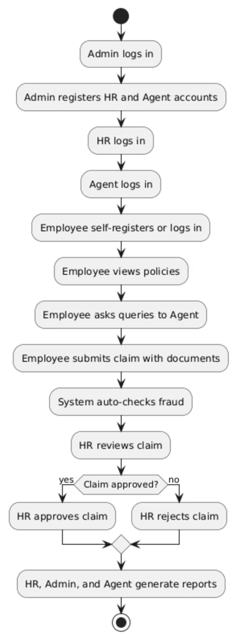
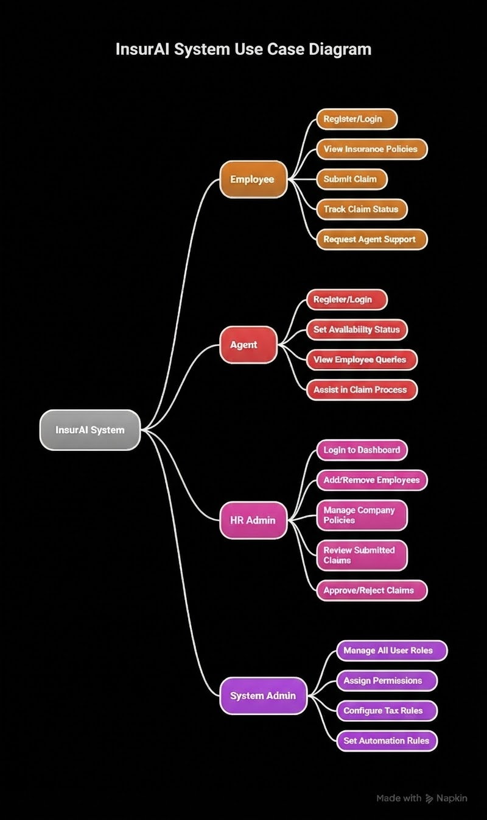

Slide 11
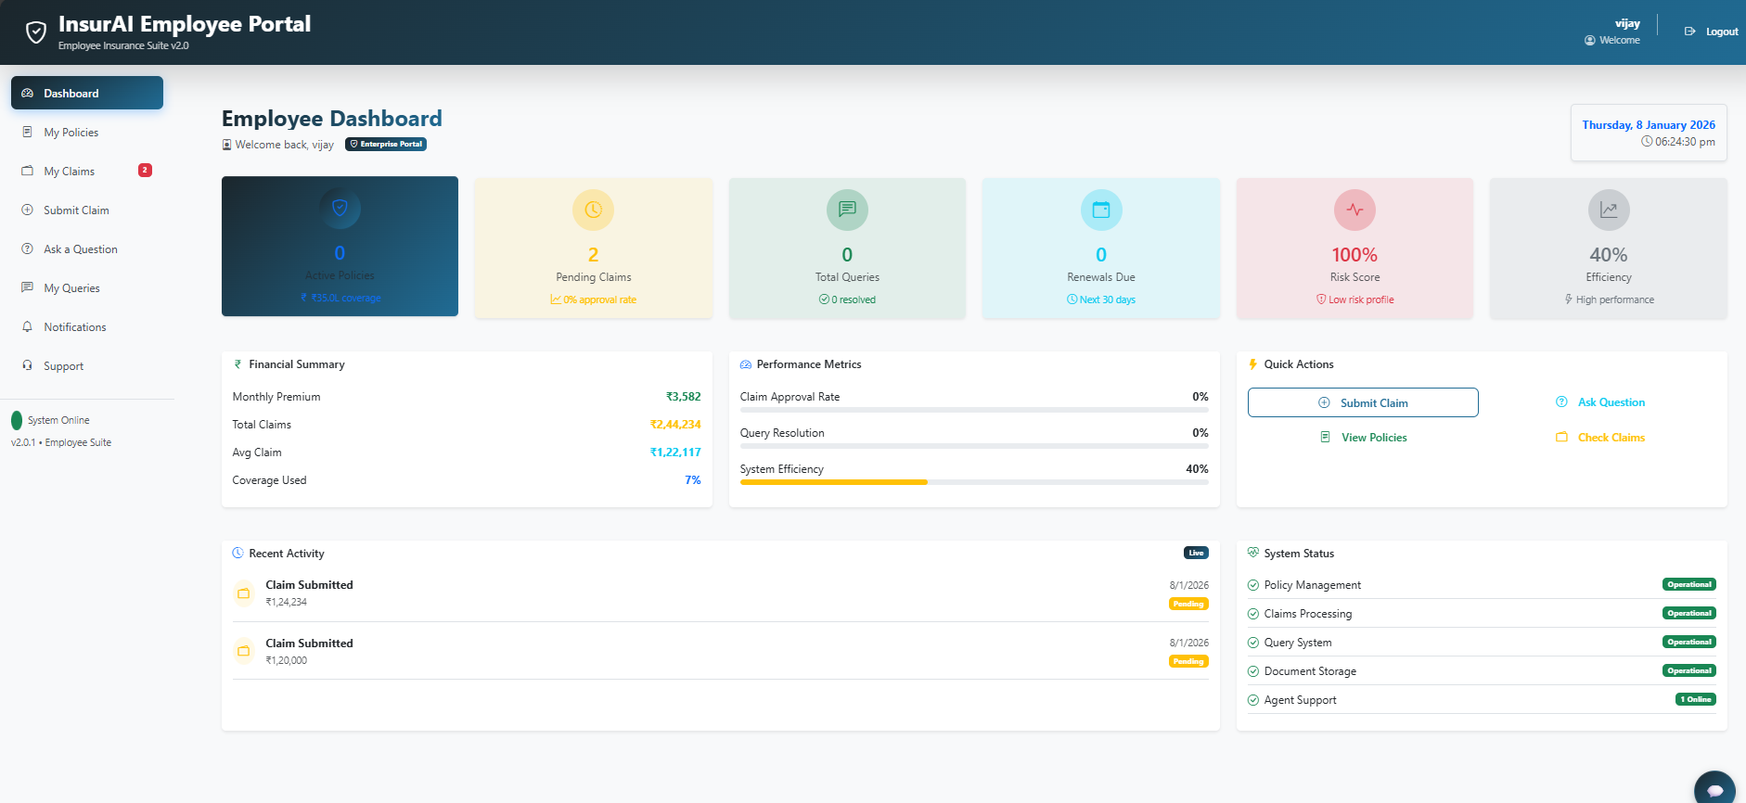
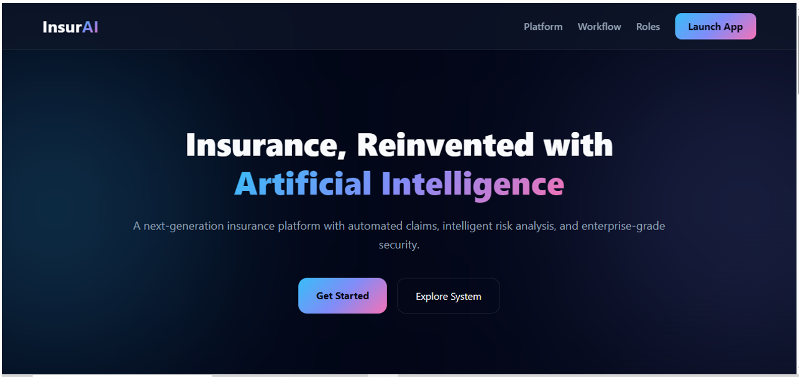
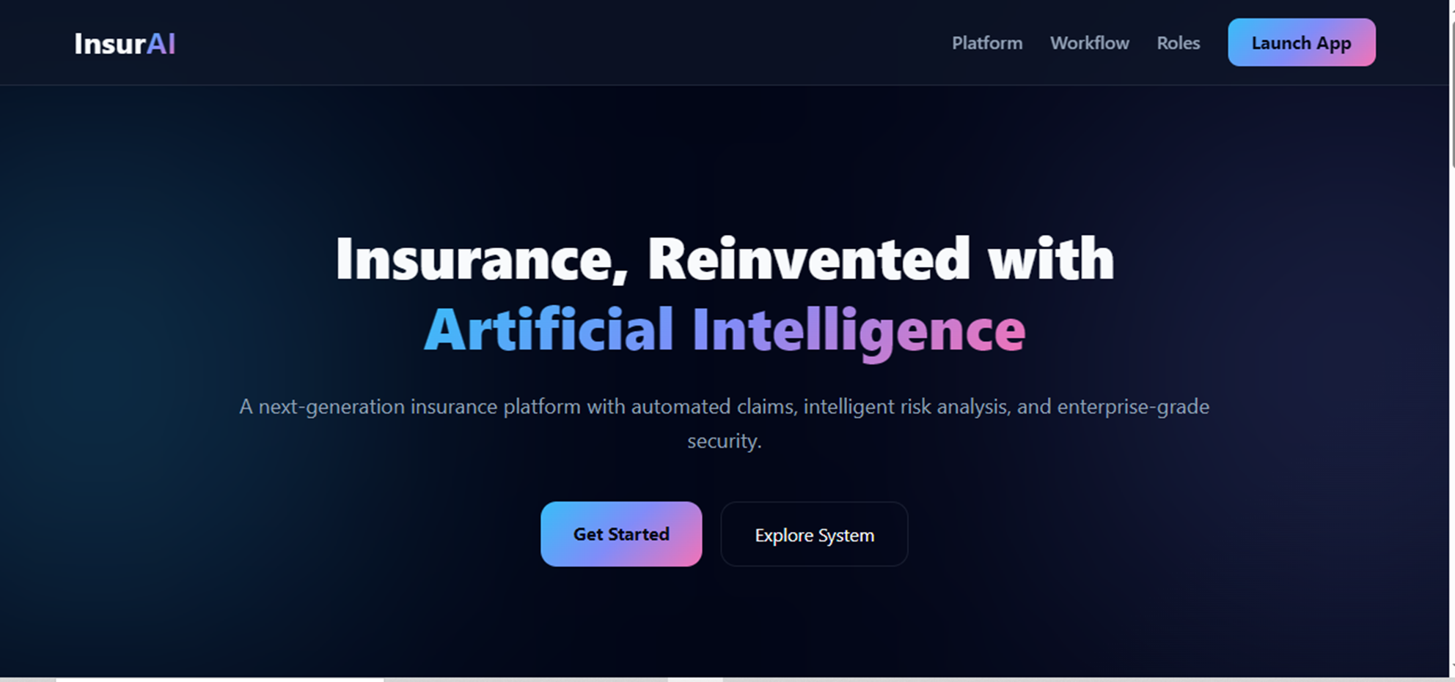

Slide 12
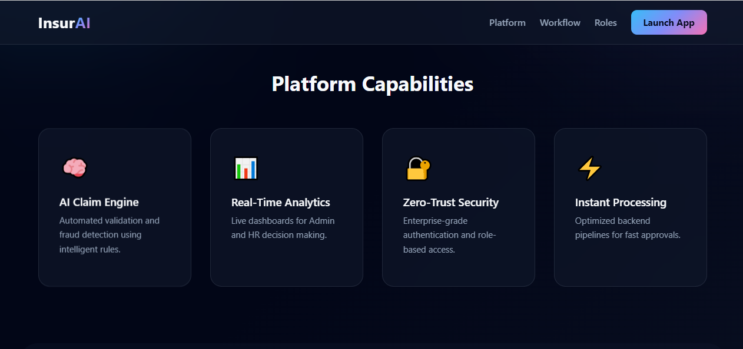

Slide 13
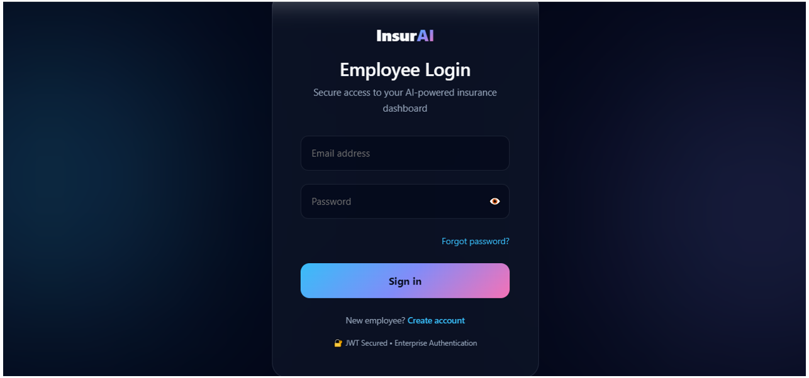

Slide 14


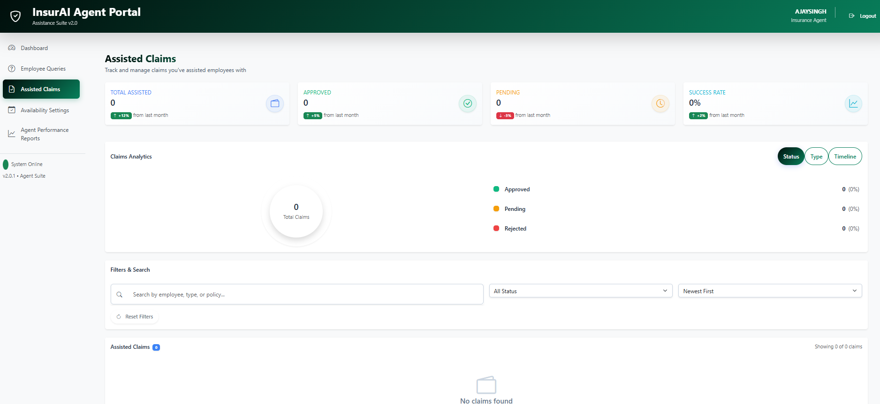
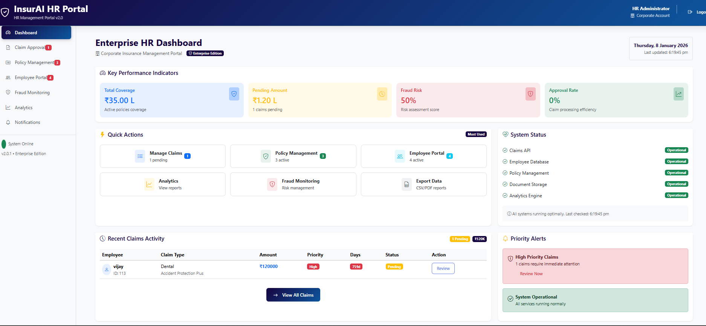

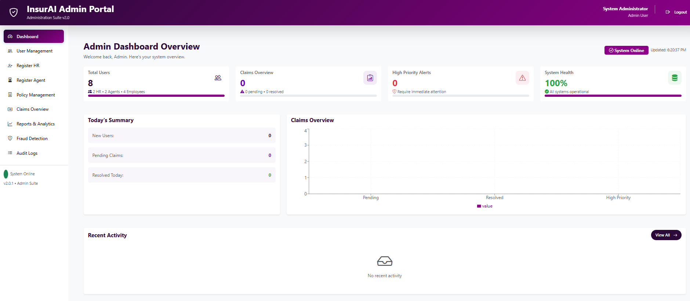

Slide 15
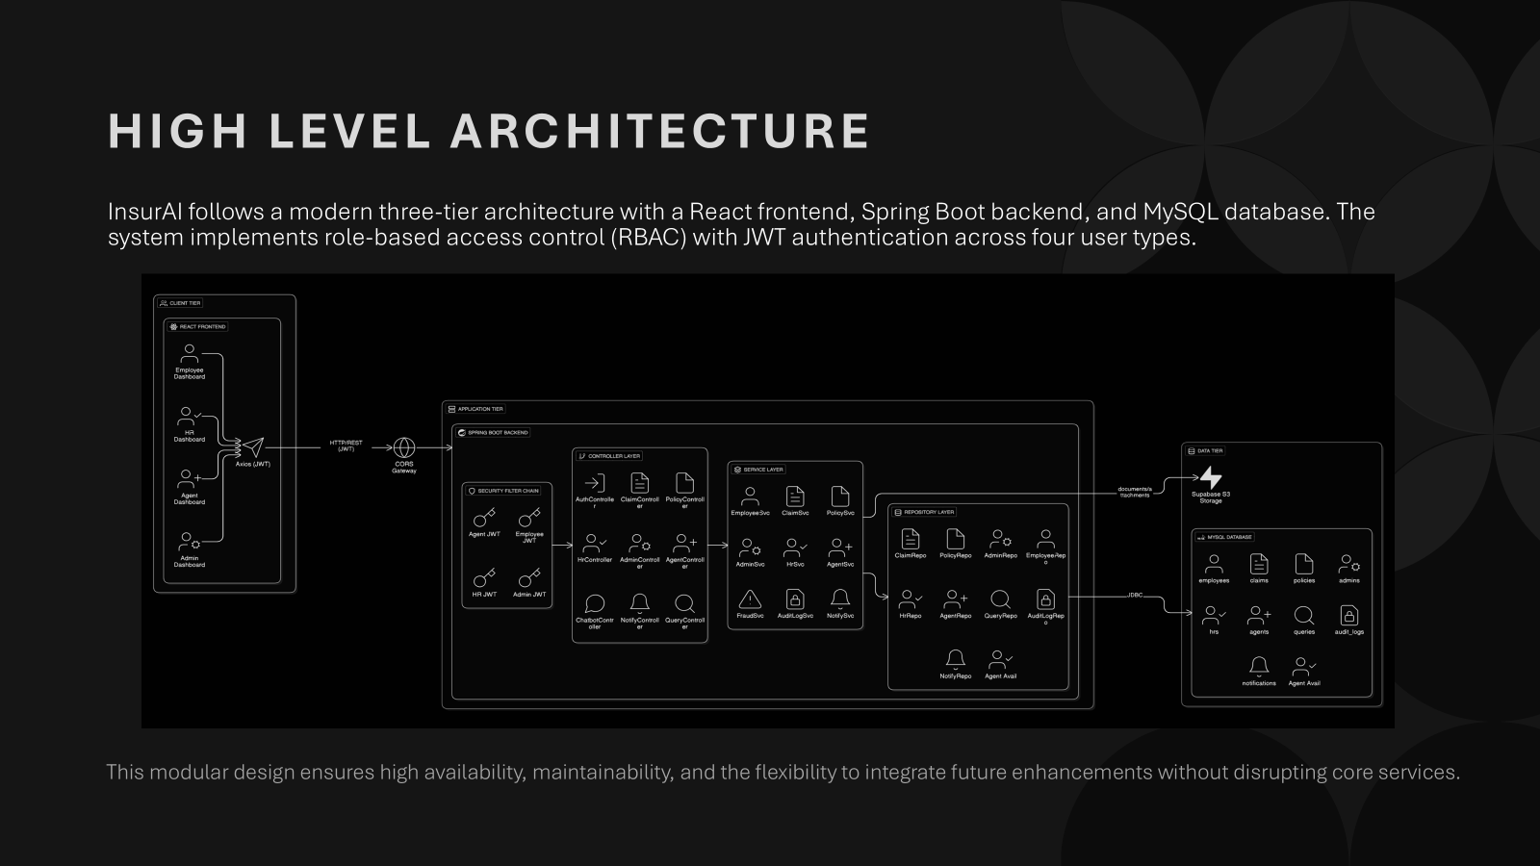
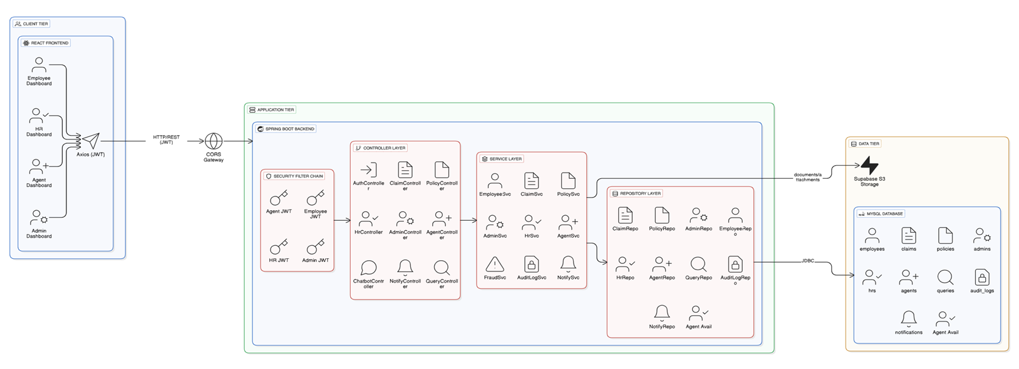

Slide 16

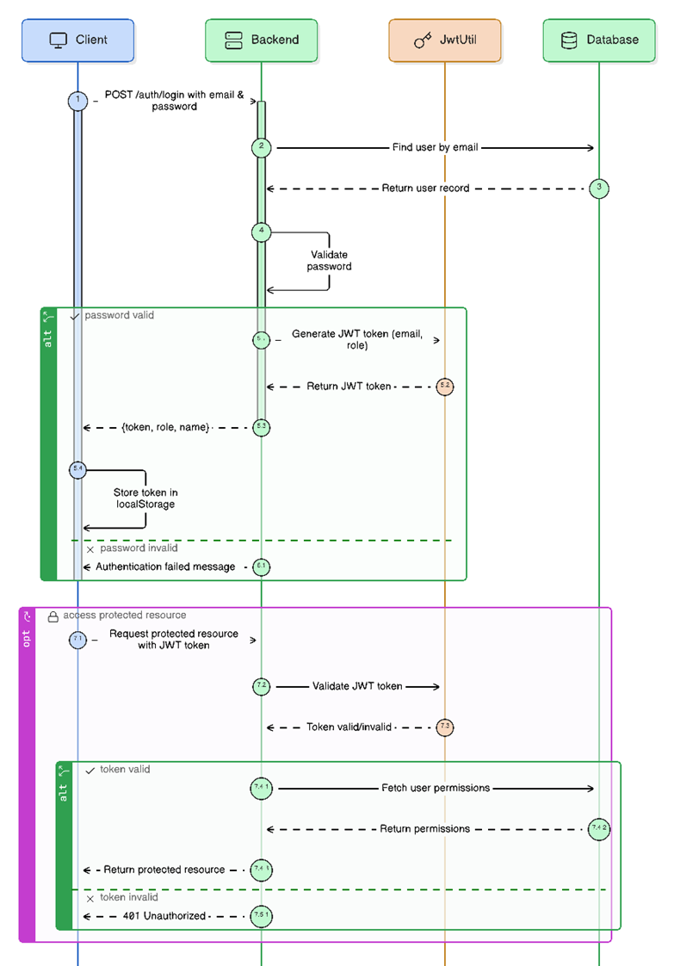




Slide 17
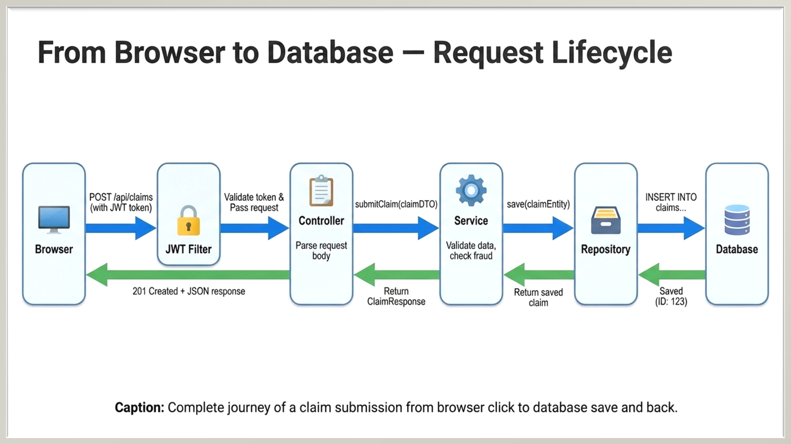
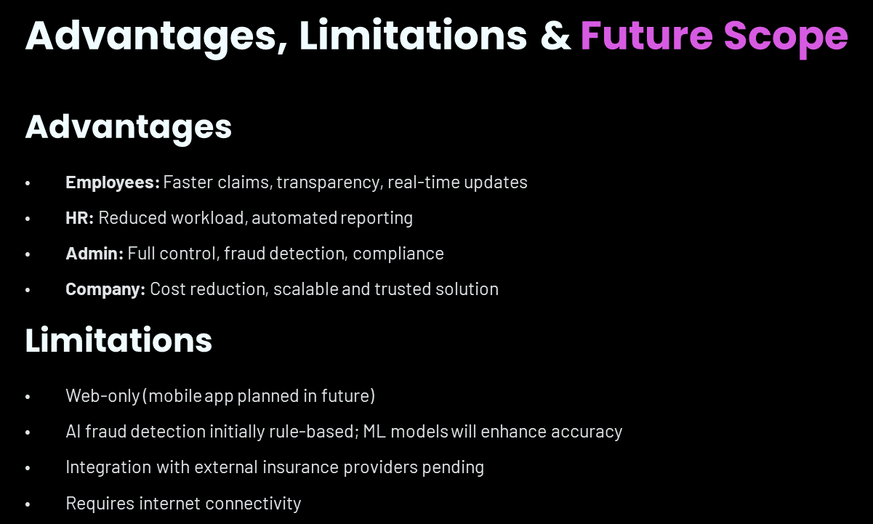
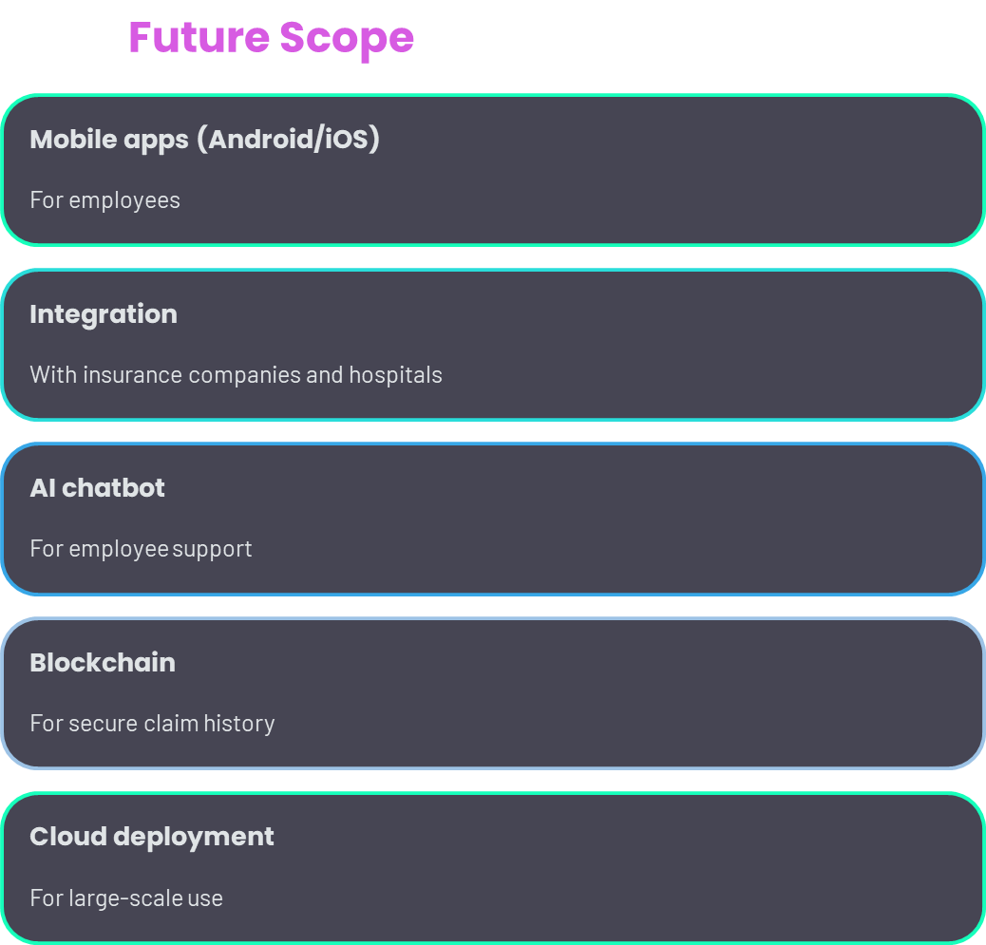

Slide 18









AI INTELLIGENCE
Fraud Detection Engine
Duplicate Detection
Anomaly Analysis
Identifies repeated claim submissions
Flags unusual claim amounts
Risk Scoring
Pattern Recognition
Assigns confidence levels to claims
Detects suspicious behavior trends
Current Implementation
Future Roadmap
Rule-based logic engine with configurable thresholds and validation criteria
Machine learning models trained on historical claim data for predictive accuracy

Slide 19

Measurable Business Impact
Measurable Business Impact
80%
80%
60%
60%
100%
100%
Faster Processing
Faster Processing
Workload Reduction
Workload Reduction
Transparency
Transparency
Claim resolution time reduced from 10 days to 2 days
Claim resolution time reduced from 10 days to 2 days
Decrease in HR administrative burden through automation
Decrease in HR administrative burden through automation
Real-time tracking visibility for all employees
Real-time tracking visibility for all employees
5-8%
5-8%
Cost Savings
Cost Savings
Estimated reduction in fraud-related losses annually
Estimated reduction in fraud-related losses annually
Data-driven policy optimization enables strategic decision-making for HR leadership, transforming insurance management from reactive to proactive operations.
Data-driven policy optimization enables strategic decision-making for HR leadership, transforming insurance management from reactive to proactive operations.

Slide 20


